Slide 1


Slide 2


Slide 3
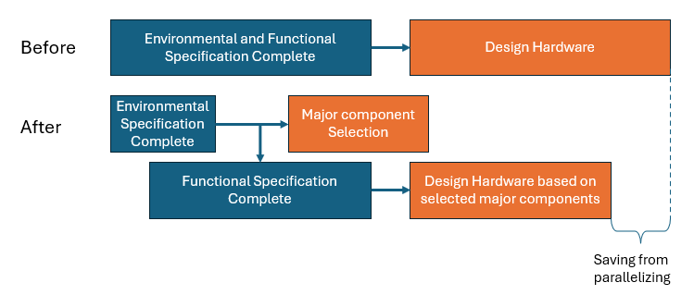
Environmental and Functional Specification Complete
Design Hardware
Before
Environmental Specification Complete
Major component Selection
After
Functional Specification Complete
Design Hardware based on selected major components
Saving from parallelizing

Slide 4


Slide 5


Slide 6


Slide 7


